Slide 1
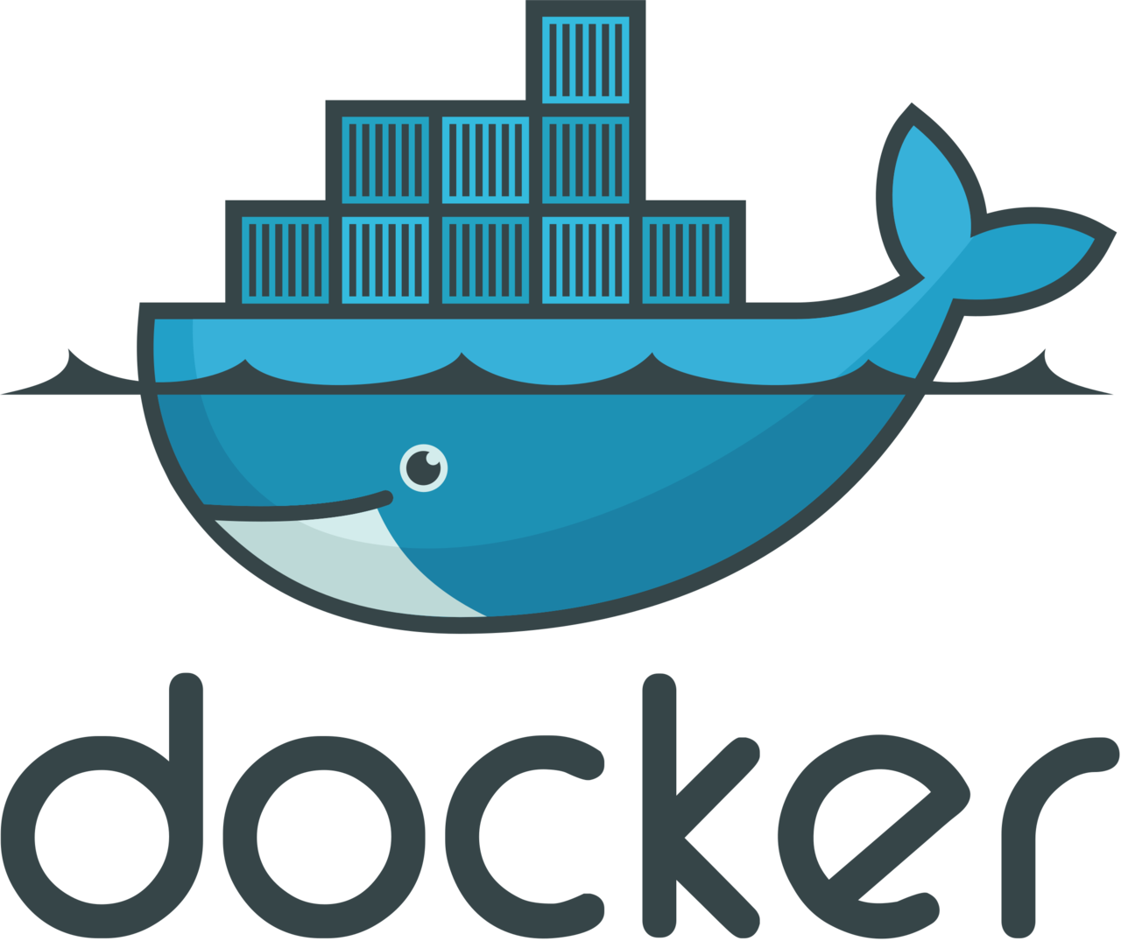

DARSHINI S

Slide 2
What is Docker
It is a virtualization software.
Makes developing and deploying applications much easier.
Docker is an open platform for developing, shipping, and running applications. Docker enables us to separate our applications from our infrastructure so we can deliver software very quickly.
By taking advantage of dockers methodologies for shipping, testing, and deploying code quickly, we can significantly reduce the delay between writing code and running it in production.

Slide 3
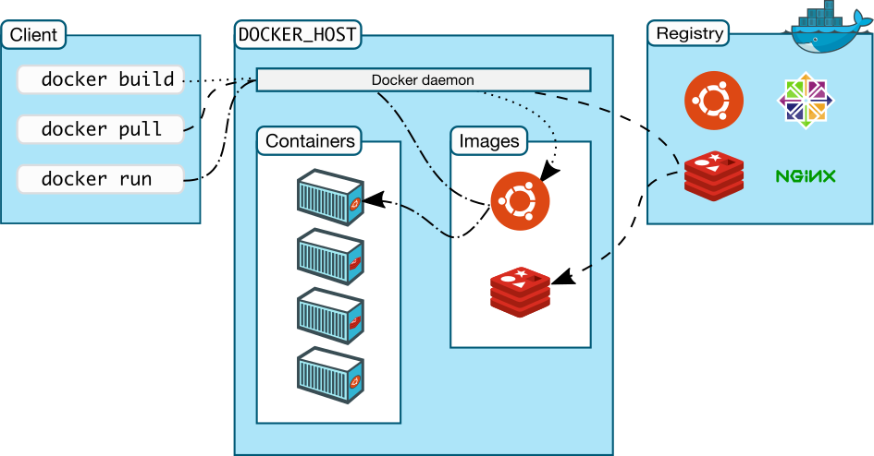
Docker Architecture
Docker uses a client-server architecture. The Docker client communicates with the Docker daemon, which is responsible for building, running, and distributing our Docker containers. The Docker client and daemon communicate using a REST API, over UNIX sockets or a network interface.

Slide 4
Docker Architecture
Docker daemon: The Docker daemon (dockerd) listens for Docker API requests and manages Docker objects such as images, containers, networks, and volumes. A daemon can also communicate with other daemons to manage Docker services.
Docker client: The Docker client (docker) is the primary way that many Docker users interact with Docker. When we use commands such as docker run, the client sends these commands to dockerd, which runs them. The docker command uses the Docker API.
Docker registries: A Docker registry stores Docker images. Docker Hub is a public registry that anyone can use, and by default Docker looks for images on Docker Hub. we can even run our own private registry.

Slide 5
Docker Components
Image
An image is a read-only template with instructions for creating a Docker container. For example, we can build an image which is based on the ubuntu image, and install the Apache web server, as well as the configuration details needed to make our application run.
we can create our own images and publish them in a registry. To build our own image, we create a Dockerfile with a simple syntax for defining the steps needed to create the image and run it.
Container
A container is a runnable instance of an image. we can create, start, stop, move, or delete a container using the Docker API or CLI. It is isolated from other containers and its host machine.

Slide 6
VM’S VS Container
  OS and Architecture: Virtual machines have a host OS and the guest OS inside each VM. Guest OS can be any OS, like Linux or Windows, irrespective of host OS. While Docker containers host on a single physical server with a host OS, which shares among them. As it shares the host OS between containers it makes them light and increases the boot time.
  Portability: Virtual machines are isolated from their OS, and so, they cannot be ported across multiple platforms. Docker containers can be easily ported across different platforms as they are self-contained and can run applications in any environment, and since they don’t need a guest OS.
Performance: Virtual machines are more bulkier than Docker containers as the virtual machines need to load the entire OS to start. The lightweight architecture of Docker containers are light weight as they don’t have a guest OS.

Slide 7
Installing the docker and some useful commands
$ sudo apt install docker.io : This command is used to installing the docker to Linux platform.
$ sudo docker --version : This shows the version is used currently in our system.
$ sudo systemctl start docker : This command starts the docker in first time when we installed the docker first time our system.
$ sudo systemctl status docker : This command shows the whether the docker is enabled or not .
$ sudo docker info : This command shows the number of images and container running in the system with the information of status of them.

Slide 8
Docker Image command list
$ sudo docker image ls: List local images
$ sudo docker rmi <image_id>: Delete an Image
$ sudo docker image prune: Remove all unused images
$ sudo docker run –it <image_id> /bin/bash: To run the image

Slide 9
Docker Hub Command List
$ sudo docker login: Login into Docker Hub
$ sudo docker push <username>/<image name>: Publish an image to Docker Hub
$ sudo docker pull <image name>: Pull an image from a Docker Hub
$ sudo docker search <image name>: Search Hub for an image
$ sudo docker logout: Logout from docker Hub

Slide 10
Docker Container Command List
$ sudo docker ps: listing the containers which is in running state
$ sudo docker ps –a: list the all containers
$ sudo docker rmi <container_id>: Delete an Container
$ sudo docker start container_id: This command start containers
$ sudo docker stop container_id: this command stop one or more running containers
$ sudo docker restart container_id: This command restarts one or more containers
$ sudo docker rename container_id new_name: The docker rename command renames a container

Slide 11
Docker Container Command List
$ sudo docker attach container_id: This command is used to attach your terminal’s standard input, output, and error.
$ sudo docker kill <container_id>: This command will kill one or more running containers.
$ sudo docker wait container_name: This command is used to wait.
$ sudo docker container prune: This command removes all stopped containers
$ sudo docker pause comtainer_id: This command will pause all processes within one or more containers
$ sudo docker unpause container_id: This command will unpause all processes within one or more containers

Slide 12
Docker File
A docker file is a document that contains scripts or instructions using which an image can be created
Creating a Dockerfile
Syntax:
$ nano Dockerfile
FROM: FROM keyword is used to specify the base image and will create a layer using docker image
LABEL: LABEL is used to add metadata to docker objects such as images, containers, local daemons, volumes, networks, swarm nodes and swarm services.
ENV: The ENV instruction is used to provide environment variables to an image which are persisted when a container is run.

Slide 13
Docker File
RUN: The RUN instruction is used to execute any command in a new layer on top of the current image and the resulting image will be used for the next step in the docker file.
WORKDIR:The WORKDIR instruction is used to set or change the working directory for any instruction that follows it in the Dockerfile.
Set the working directory for any subsequent ADD, COPY, CMD, ENTRYPOINT, or RUN instructions that follow it in the Dockerfile.
COPY:The COPY instruction is used to copy the files or directories from the specified source to the destination inside the container’s file system.

Slide 14
Docker File
ADD: The ADD instruction is also used to copy the files or directories from the specified source to the destination inside the container’s file system.
CMD:The CMD instruction is used to provide a default executable or an entry point for an executing container. The executable provided in CMD instruction will launch automatically when the container is run.
EXPOSE:The Expose instruction informs that the container is listening to the specified port in the network.

Slide 15
Example
FROM python
LABEL name=“Darshini"
LABEL email=“darshinis3103@gmail.com"
ENV USERNAME darshini3103
ENV PASS Darshini_31
WORKDIR /app
ADD requirements.txt requirements.txt
RUN pip install -r requirements.txt
CMD ["python","manage.py","makemigrations","migrate","runserver", "127.0.0.1:8000"]

Slide 16
Docker Volume
Docker containers data is volatile. If we create any file in /temp folder and by mistake if we delete the container, that file and directory will also be deleted.
To make docker data persistent we have docker volumes are the preferred mechanism for persisting data generated by and used by Docker containers.

Slide 17
Docker Volume Command List
Create
$ sudo docker volume ls: check the created volume
$ sudo docker volume create darshini: Create new Volume
Remove and prune
$ sudo docker volume rm darshini: To remove the volumes.
$ sudo docker volume prune: To remove all the unused volumes.

Slide 18
Docker Compose
Compose is a tool for defining and running multi-container Docker applications. With Compose, we use a YAML file to configure our application’s services. Then, with a single command, we create and start all the services from our configuration.
Bellow example shows the simple usage of docker-compose file
version: '3.3’
services:
webapplication1:
image: nginx
ports:
- "8000:80"

Slide 19
Docker Compose
Version: - Property is defined by the specification for backward compatibility.
Services:- It defines the number of applications or containers which need to be created. As shown in the above example under webapp1 it defines the first container which will get created using image nginx and expose ports “8000:80”. Now, suppose we want to create two containers using docker-compose YAML file. It's very easy ,just require one more webapp to be defined inside YAML file as shown below.
version: '3.3'
services:
webapplication1:
image: nginx
ports:
- "8000:80"
webapplication2:
image: nginx
ports:
- "8001:80"

Slide 20
Docker Compose Command List
$ sudo docker-compose create: This command is used to create a container and it will just create.
$ sudo docker-compose up –d: This command is used to create and start the container
$ sudo docker-compose start: It will start the container and status of this will up
$ sudo docker-compose stop: It will stop the running container
$ sudo docker-compose rm: It will remove the container
$ sudo docker-compose ps: command is used to check the state of the containers.

Slide 21
Docker Compose Command List
$ sudo docker-compose pause: This command is used to pause the container.
$ sudo docker-compose unpause: This command is used to unpause the paused container
$ sudo docker-compose kill: This will kill the container
$ sudo docker-compose run: Docker-compose run command will create a new container and then runs the command inside it.
$ sudo docker-compose restart: It will restart the container
$ sudo docker-compose pull: Will pull the images(that we are using docker-compose.yaml) from the repository

Slide 22
THANK YOU

